Slide 1
Plotting & Scheming
The secrets to creating sustainable perennial food plots

Slide 2
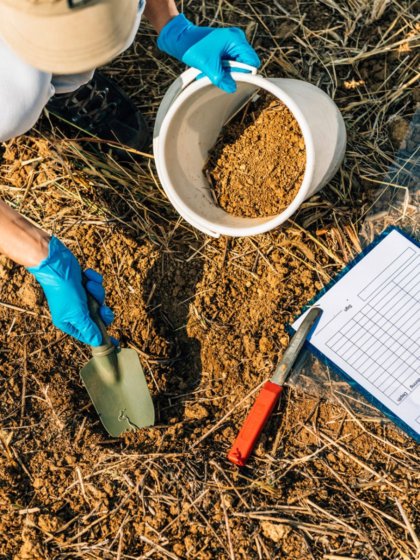
Soil Testing
Ph levels
Fertilizer prescription for optimal yield
Organic make up
Soil structure

Slide 3
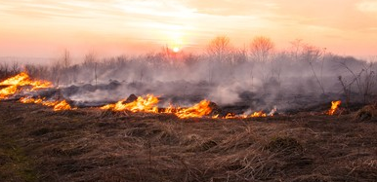
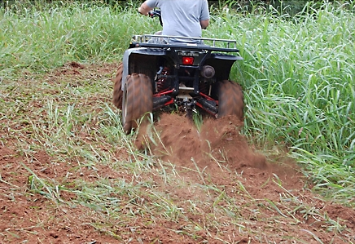
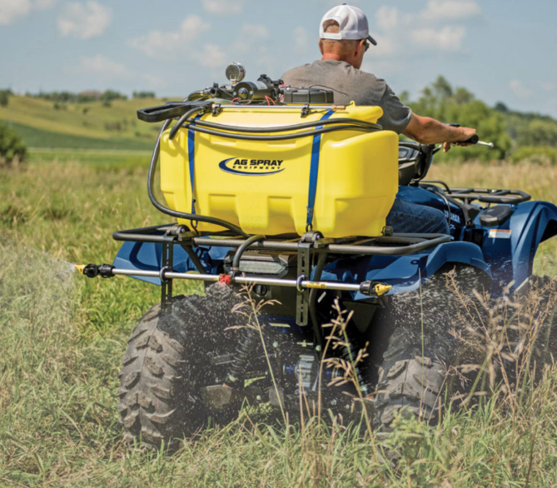
Plot Preparation
Mechanical
Chemical (2,4D/Glyphosate/Simizine) Timing!!!!
Prescribed Fire

Slide 4
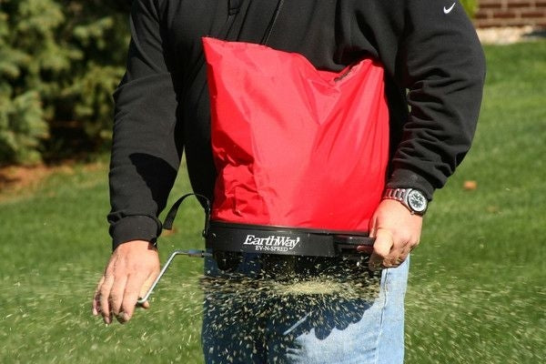
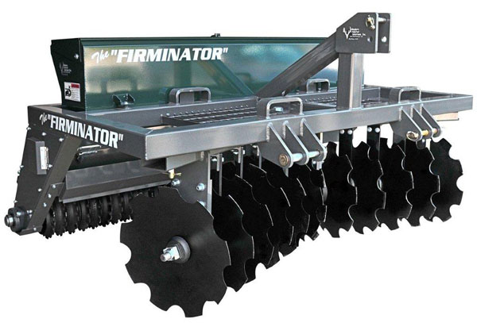
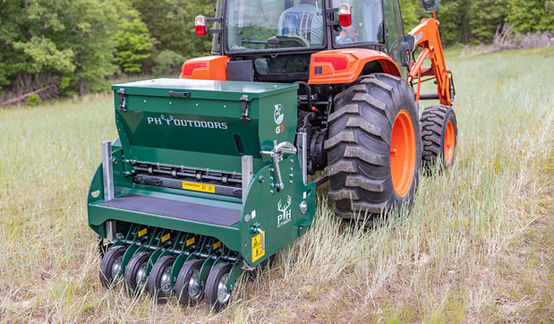
Planting Options
Broadcast
Planter/Drill
No-till

Slide 5
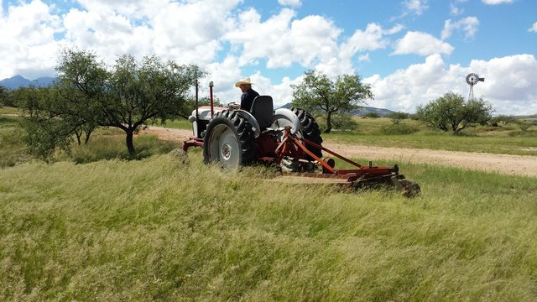
Maintenance
Mechanical-Mowing
Chemical-”Grassout” (chlethodim)

Slide 6
Setting Realistic Expectations
Harvest Goals
Surrounding cover/bedding areas
Other food in the neigborhood
Entry and exit strategies

Slide 7
Questions Comments or Concerns
Making a measurable difference is the difference…

